Slide 1
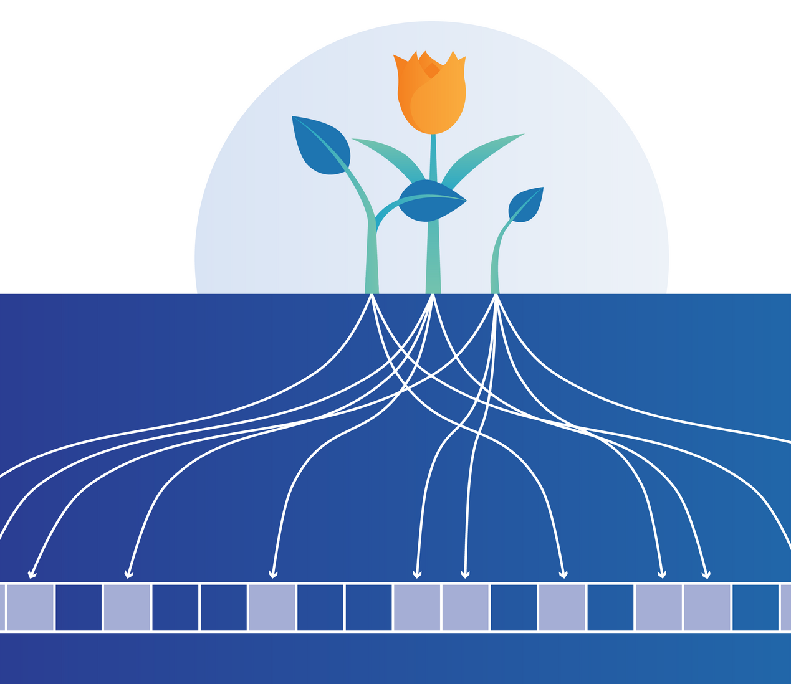
TOPIC 3 STREAM MINING: Bloom Filter and Count-distinct
Presented by: Ali Pour Sotoudeh Tehrani, 6500326

Slide 2
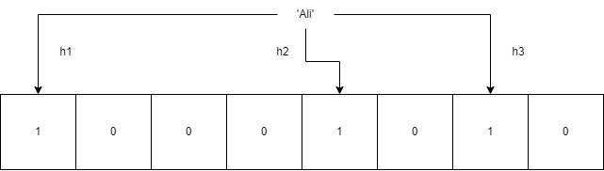
Bloom filter
A space and time-efficient probabilistic (false positive possible) data structure
It is used to check if given data is already included in a set
How do we use it:
Initialize an n bit array with zeros in it
K hash functions that will be used to check if our value is in the bit array ( bloom filter)

Slide 3
Flajolet-Martin algorithm
Count the number of unique elements in a multiset
Algorithm:
An auxiliary function returns the first 1-bit of the binary representation of the hash
Bitmap to keep track of first-one bits patterns
R is first zero in bitmap -> cardinality is 2^{R}
Divide by correction factor 0.77351
Also, use multiple hash functions and use average
Uniform hash-function -> integer in interval [0 , 2^{L} - 1] L – bits

Slide 4
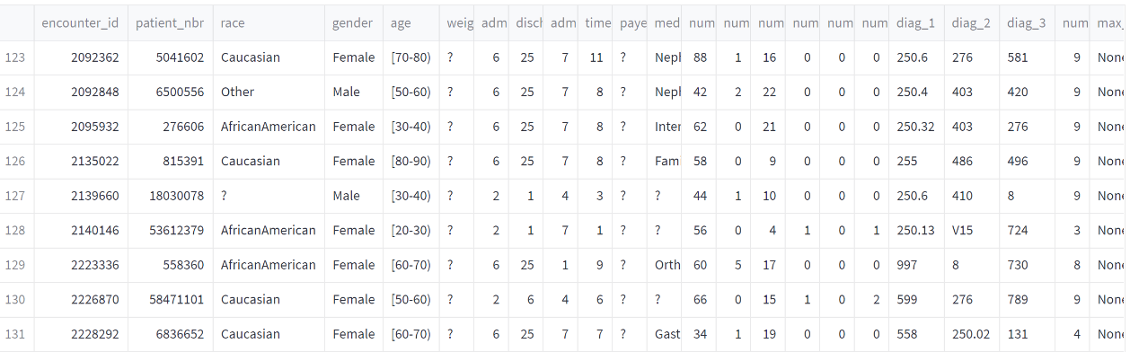
Dataset
Diabetes data from 130-US hospitals for years 1999-2008
101766 rows , 71518 unique patient numbers ( bloom filter)
It includes over 50 features representing patient and hospital outcomes.
This data has been prepared to analyze factors related to readmission as well as other outcomes pertaining to patients with diabetes.

Slide 5
Bloom filter implementation
generateBloomfilter(n_bits):
return np.zeroes(n_bits)
insertBloomfilter(bloom_filter, value):
for every hash function:
bloom_filter[hash_function(value)] = 1
queryBloomFilter(bloom_filter, value):
for every hash function:
if bloom_filter[hash_function(value)] = 0:
return ‚miss‘
return ‚match‘

Slide 6
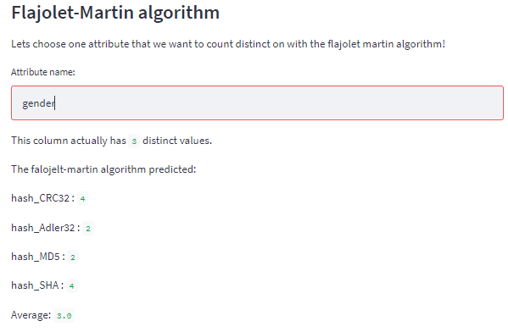
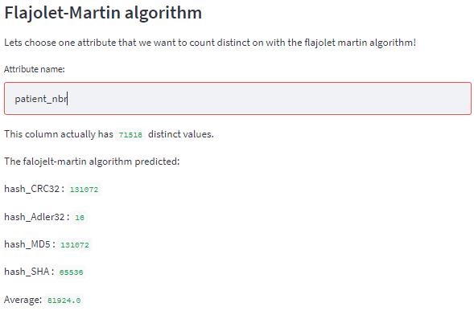
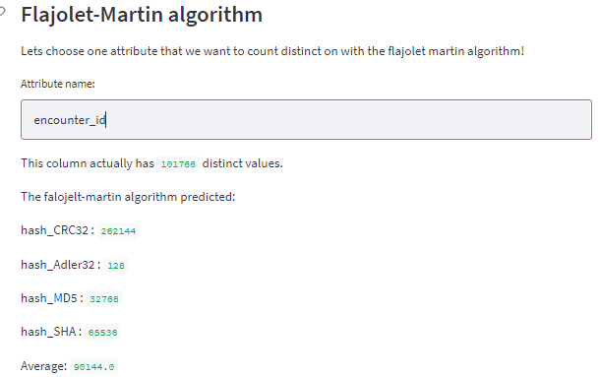
Flajolet Martin algorithm
Not implemented my self (see sources)
Streamlit interactive cell to chose column

Slide 7
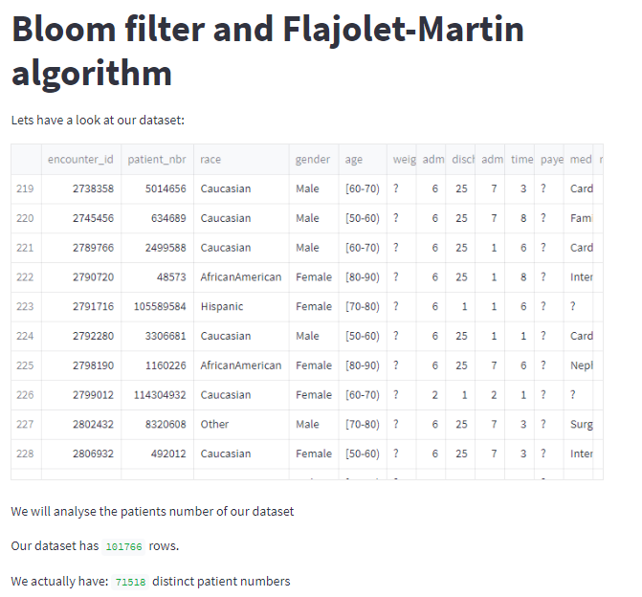
Interactive webpage (1/3)
Build with python package streamlit
Three sections:
Introduction (Dataset overview)
Bloom filter
Flajolet Martin algorithm

Slide 8
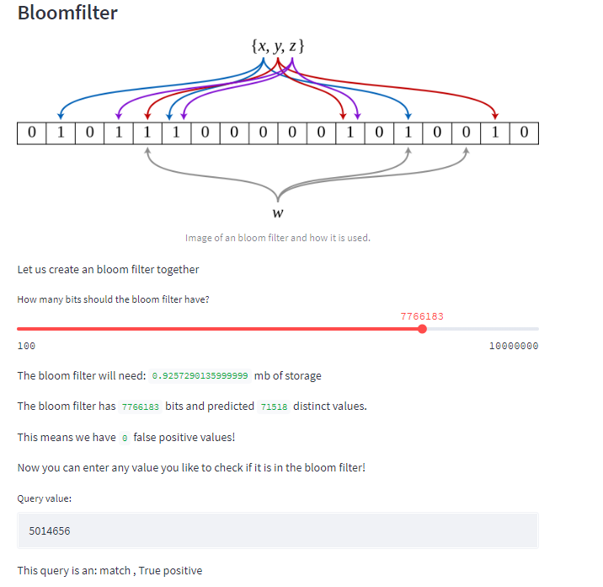
Interactive webpage (2/3)
Slider for size of bit array:
Reports storage size
False positive on all patient_nbr
Query field to check if value in bloom filter
Check if tp, fp, tn, fn

Slide 9
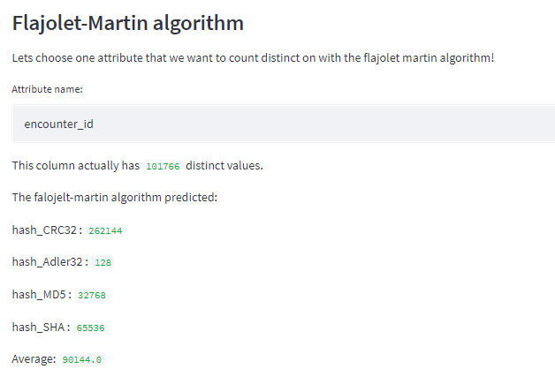
Interactive webpage (3/3)
Flajolet-Martin Algorithm
Choose a column and see what the different hash functions approximate

Slide 10
Sources
Flajolet-Martin algorithm:
https://github.com/lucasschmidtc/Probabilistic-Algorithms/blob/master/Probabilistic%20Algorithms.ipynb
Dataset:
https://archive-beta.ics.uci.edu/ml/datasets/diabetes+130+us+hospitals+for+years+1999+2008
My github repo:
https://github.com/AliPTehrani/DS1_Bloomfilter_flajolet_algo
Images:
https://www.google.com/imgres?imgurl=https%3A%2F%2Fblog.cloudflare.com%2Fcontent%2Fimages%2F2020%2F02%2Fbloom-filter%402x.png&imgrefurl=https%3A%2F%2Fblog.cloudflare.com%2Fwhen-bloom-filters-dont-bloom%2F&tbnid=4ZBtTVcw8qgoRM&vet=12ahUKEwj-0OHZjZn4AhWE_bsIHUIyAlkQMygHegUIARCuAQ..i&docid=TeEQDO3AVbLknM&w=2000&h=1098&q=bloom%20filter&ved=2ahUKEwj-0OHZjZn4AhWE_bsIHUIyAlkQMygHegUIARCuAQ
https://www.google.com/imgres?imgurl=https%3A%2F%2Fupload.wikimedia.org%2Fwikipedia%2Fcommons%2Fthumb%2Fa%2Fac%2FBloom_filter.svg%2F1280px-Bloom_filter.svg.png&imgrefurl=https%3A%2F%2Fcommons.wikimedia.org%2Fwiki%2FFile%3ABloom_filter.svg&tbnid=vYtex-1LSw9ECM&vet=12ahUKEwj-0OHZjZn4AhWE_bsIHUIyAlkQMygAegUIARCgAQ..i&docid=yJ6ECUj91jbTXM&w=1280&h=460&q=bloom%20filter&ved=2ahUKEwj-0OHZjZn4AhWE_bsIHUIyAlkQMygAegUIARCgAQ

Slide 11
Thank you for your attention! Question ?

